Slide 1
FA with Output … Mealy Machine
--- Sakshi Surve

Slide 2
FA with Output associated with a State :
Moore Machine
FA with Output associated with a Transition :
Mealy Machine

Slide 3
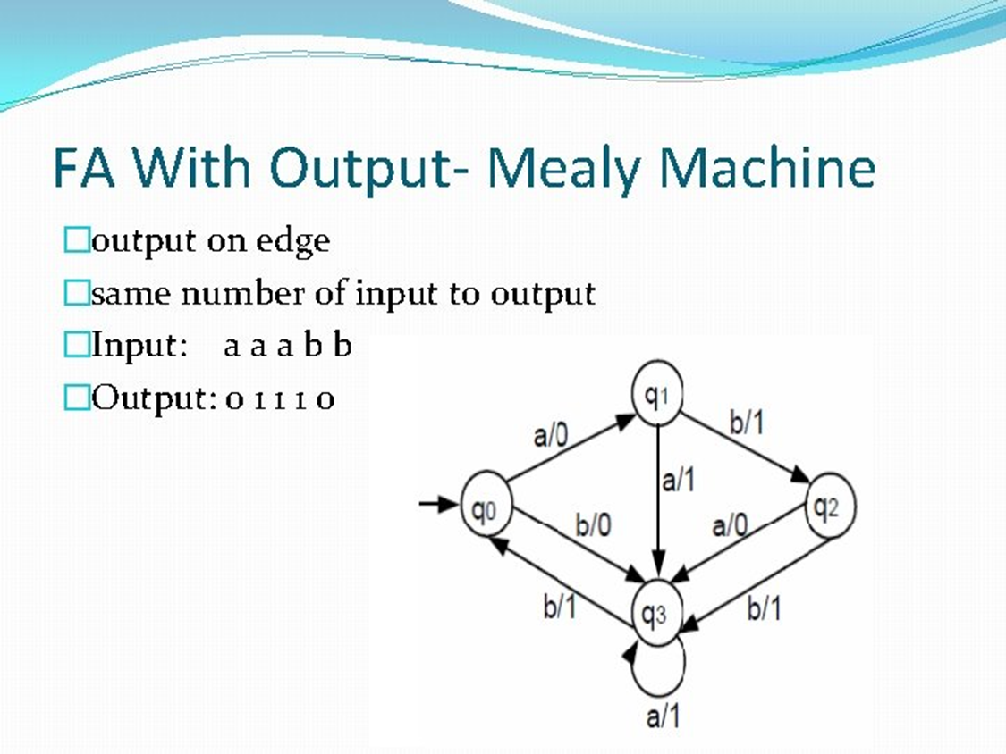

Slide 4
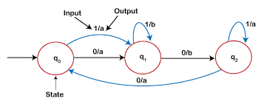

Slide 5
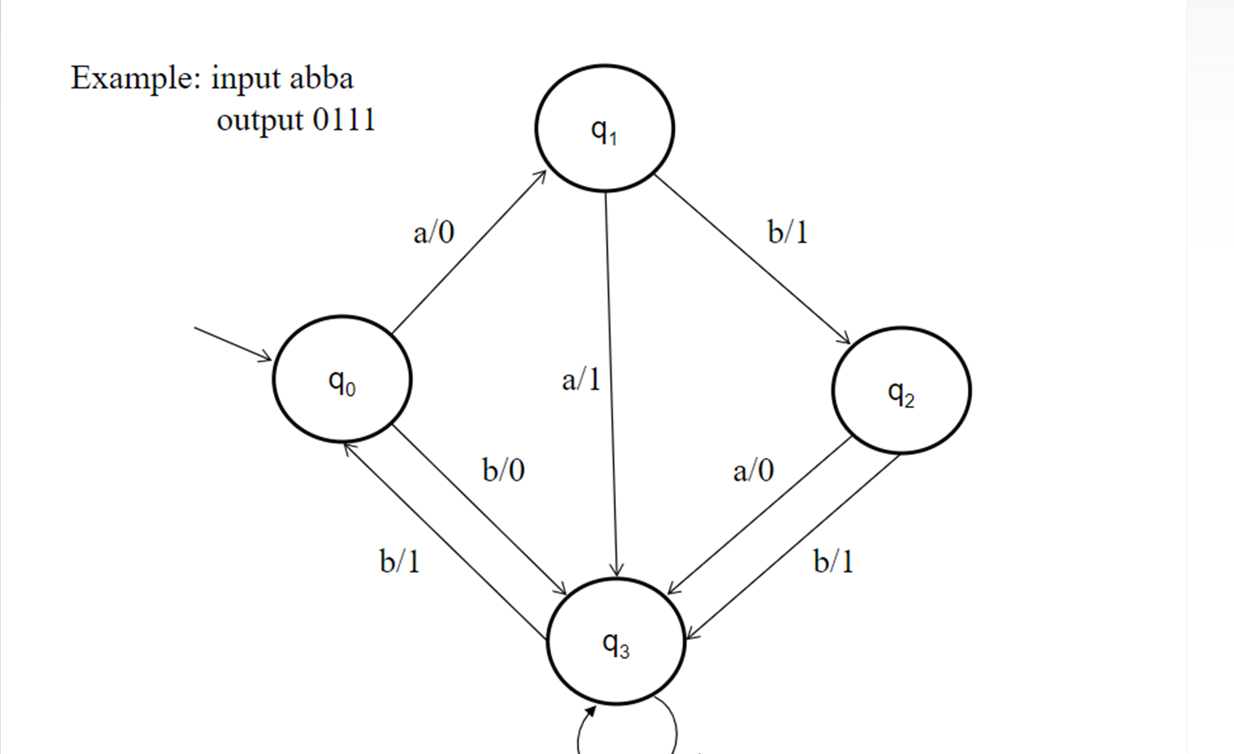

Slide 6
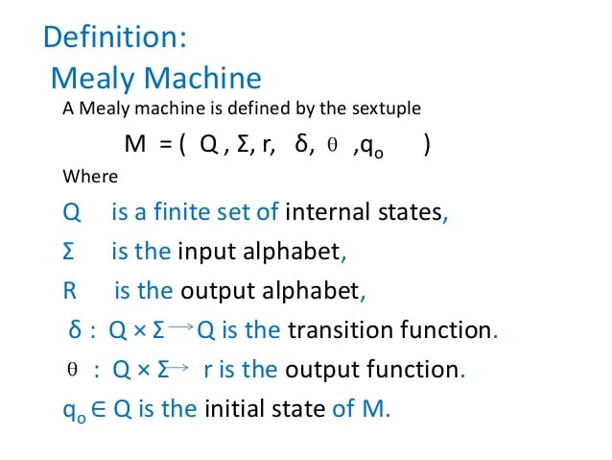

Slide 7
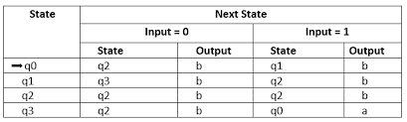

Slide 8
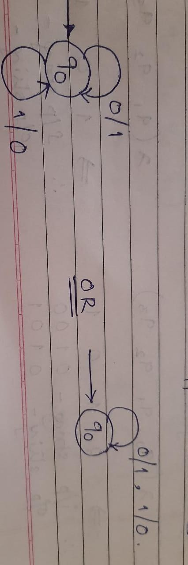
Design Mealy Machine to find one’s complement of a binary input string

Slide 9
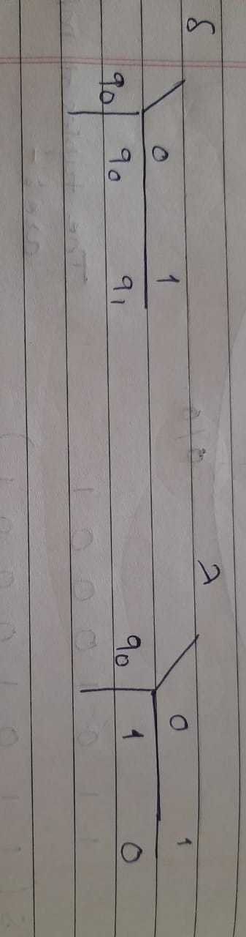
Transition Mapping Function
Output Mapping Function

Slide 10
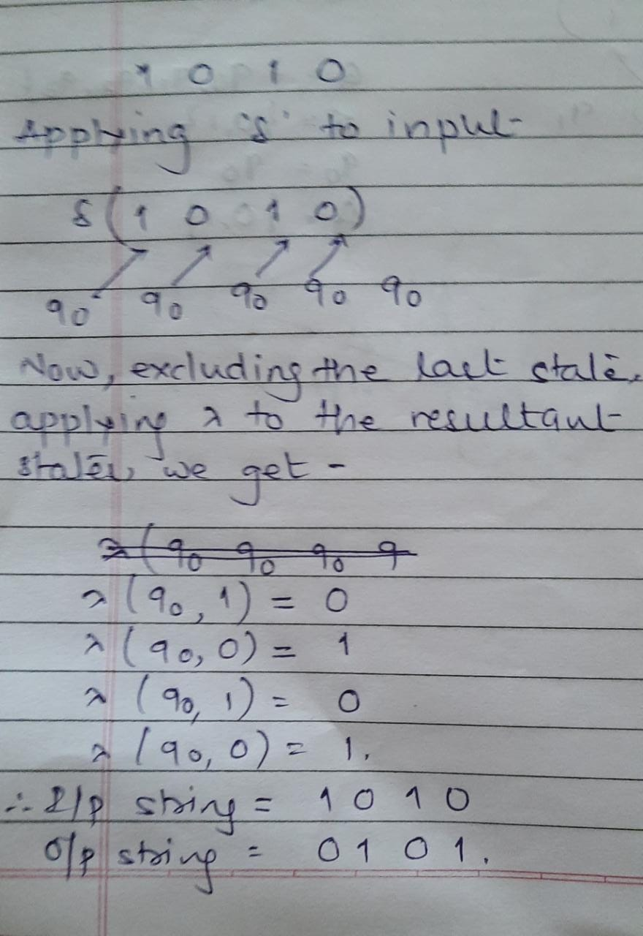
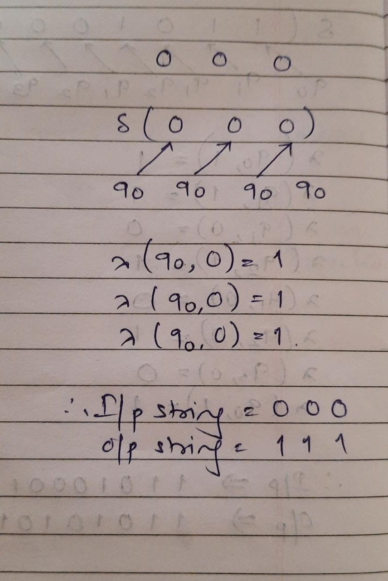
Examples :

Slide 11
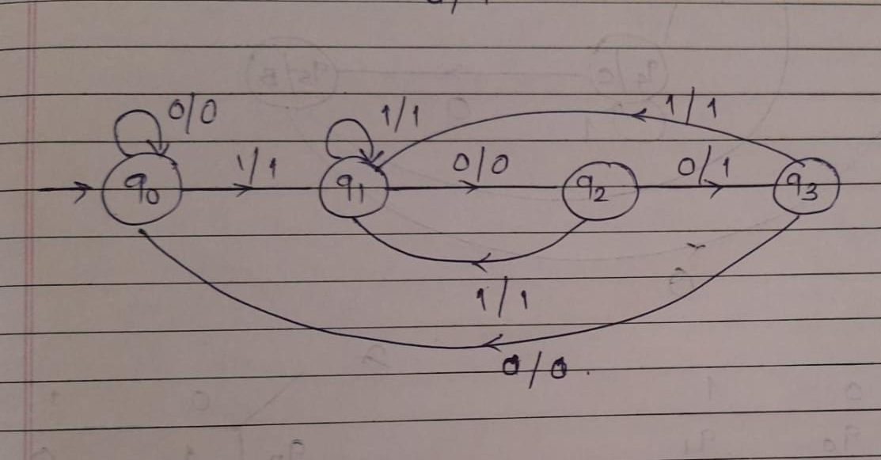
Design Mealy Machine to convert every occurrence of 100 to 101

Slide 12
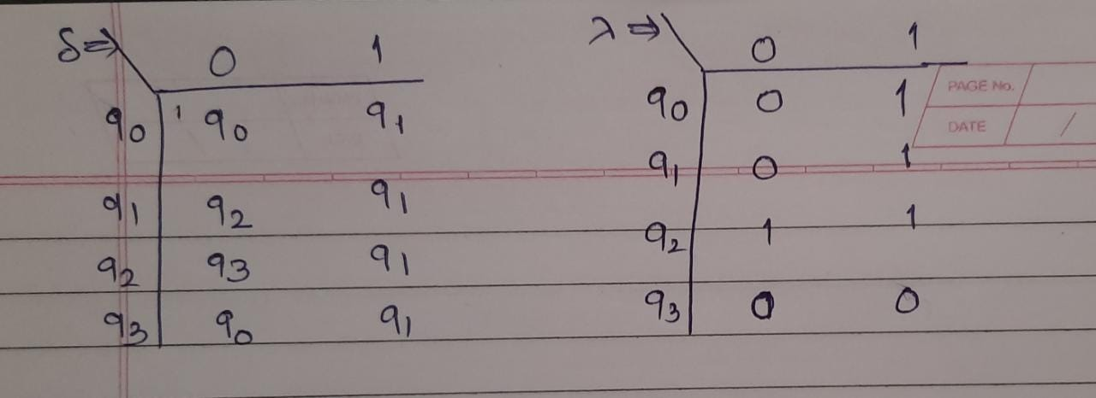
Transition Mapping Function
Output Mapping Function

Slide 13
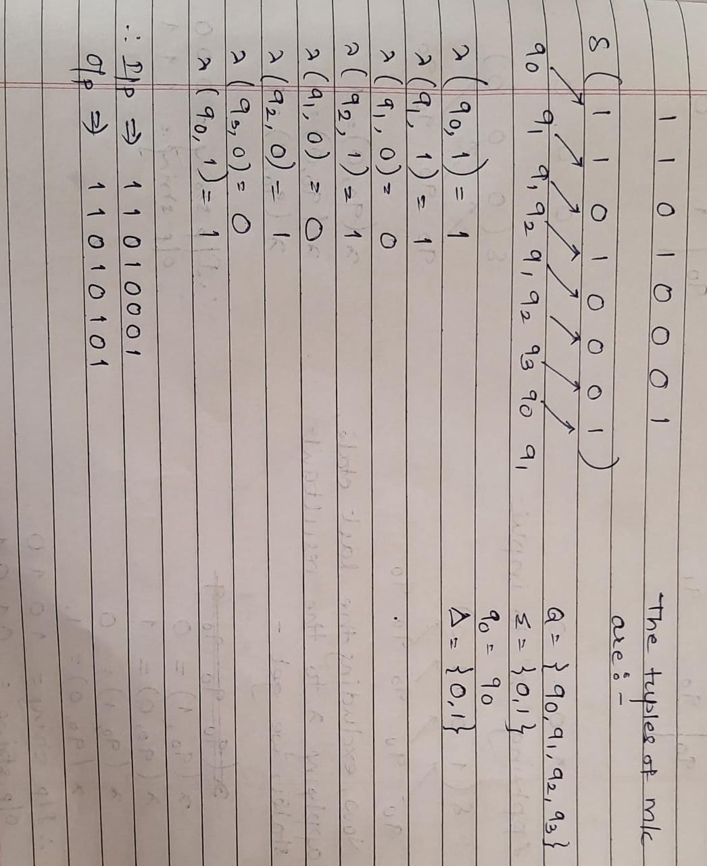

Slide 14
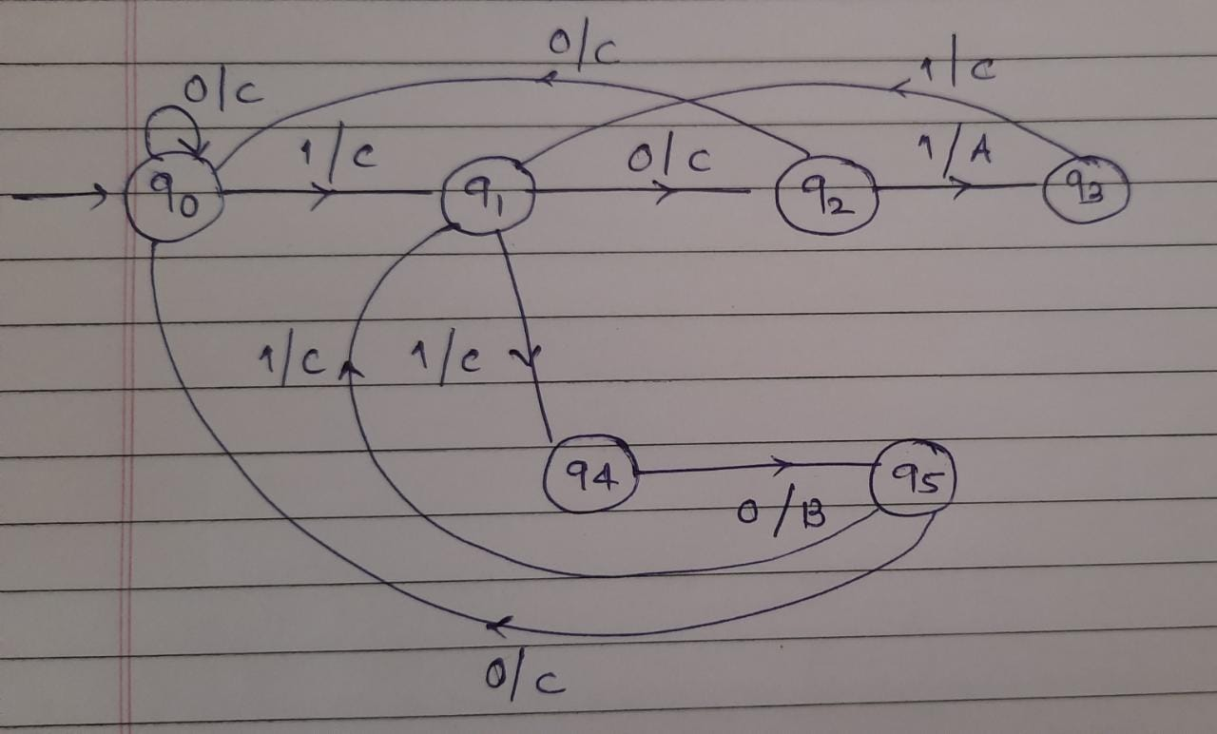
Design Mealy Machine which outputs ‘A’ if ‘101’ is recognized , outputs ‘B’ if ‘110’ is recognized, and ‘C’ otherwise

Slide 15
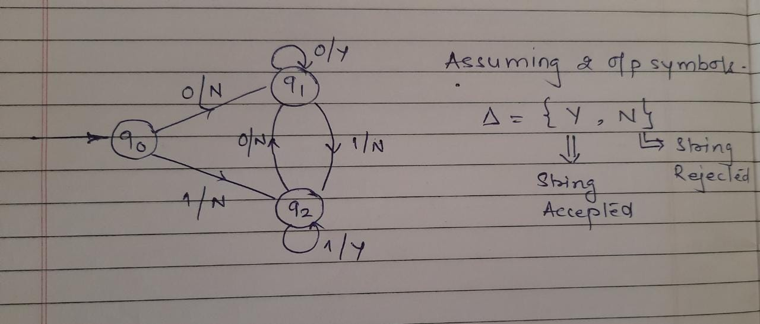
Design a Mealy Machine to accept a binary string if it ends with ‘00’ or ‘11’

Slide 16
Design Moore and Mealy Machine to determine residue modulo 3 of a binary input
Residue Modulo n = Remainder after dividing by n
The expected answer is remainder when a binary number is divided by 3 ….i.e. 0, 1, 2

Slide 17
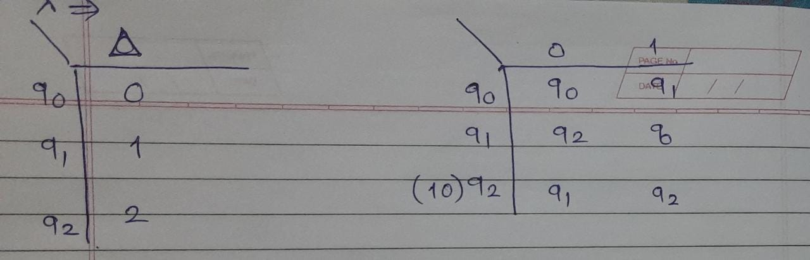
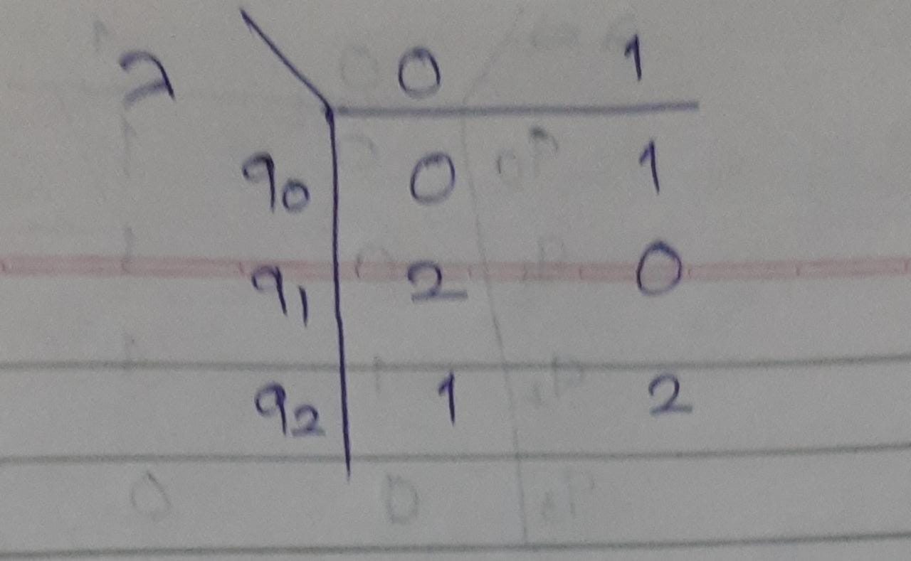

Slide 18
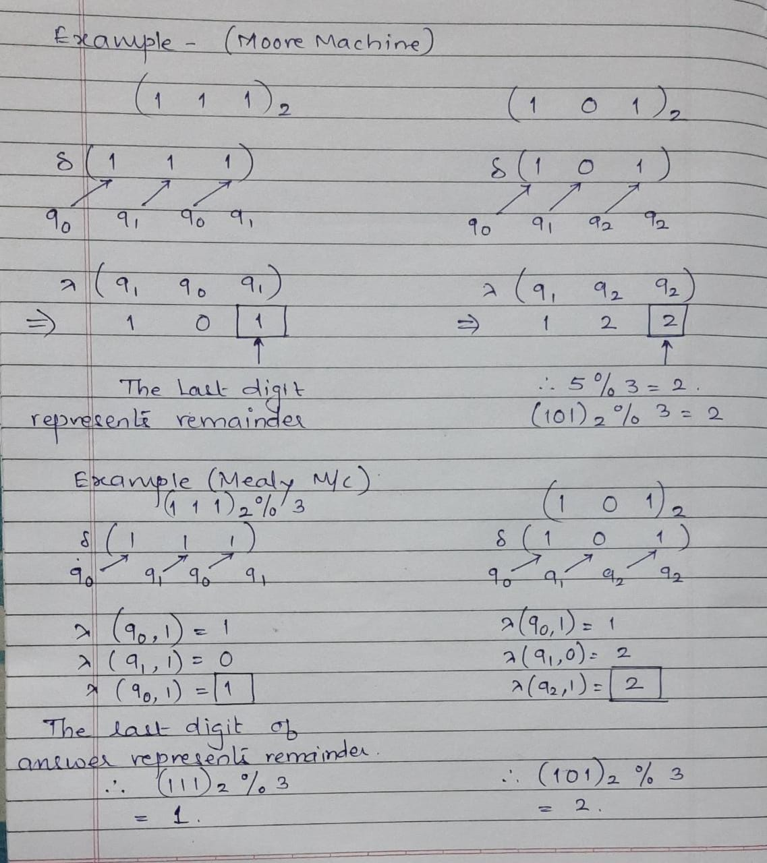

Slide 19
Homework
Design a Moore Machine to accept a binary string if it ends with ‘00’ or ‘11’
Design Mealy Machine which outputs ‘A’ if ‘101’ is recognized , otherwise outputs ‘B’
Design a Mealy machine to convert every occurrence of ‘121’ to ‘122’ over ∑ = {1,2,3}

Slide 20
Mealy Machine | Moore Machine
Output depends both upon the present state and the present input | Output depends only upon the present state.
Generally, it has fewer states than Moore Machine. | Generally, it has more states than Mealy Machine.
The value of the output function is a function of the transitions and the changes, when the input logic on the present state is done. | The value of the output function is a function of the current state and the changes at the clock edges, whenever state changes occur.
Mealy machines react faster to inputs. They generally react in the same clock cycle. | In Moore machines, more logic is required to decode the outputs resulting in more circuit delays. They generally react one clock cycle later.

